Slide 1
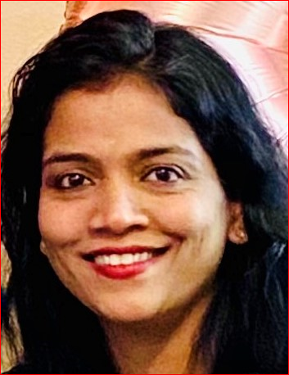
TractorTEK
Capstone Project -1
Presented by: Pratiksha Mayekar
Date : 04/14/2021

Slide 2
Instructions
First Capstone Presentation
Restore Backup in the database
Restore Broken Web App
Sales Dashboard, and Analysis in Excel
Database Design​
Focal points should be: ​
Design choices & justifications​
Value to the customer
Slides & flow
Title Slide
One slide with the name of your solution, a few screenshots, and your picture
Use this slide to very briefly introduce your app, providing a summary of how it works.
[Live Demo]
Appendix
Any supporting materials such as diagrams, that you may refer to during Q&A

Slide 3
TractorTEK
Load Backup in the database

Slide 4
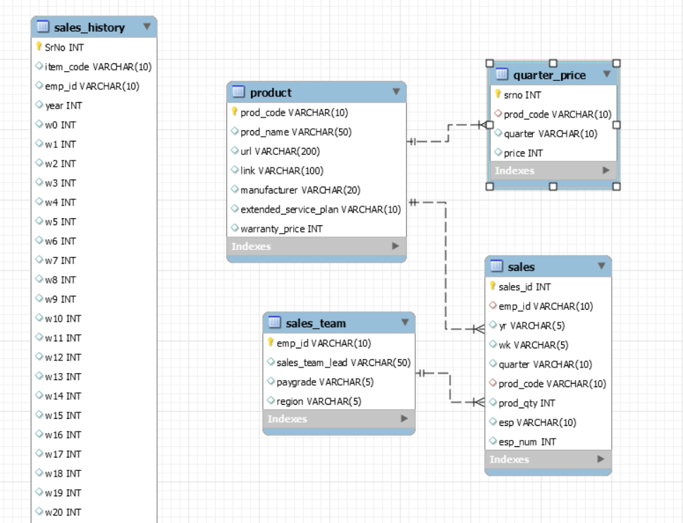
Back end – Database Design TractorTEK
OLAP
OLTP

Slide 5
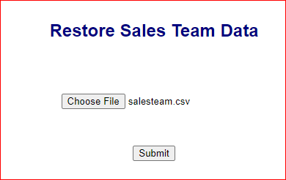
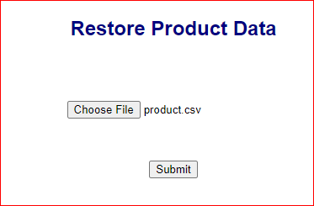
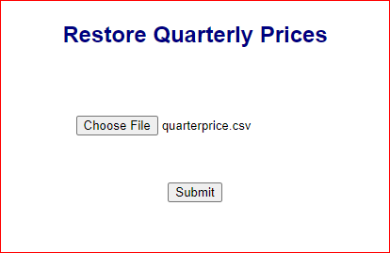
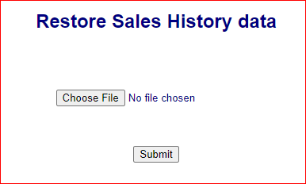
Restore TractorTEK Backup
Restore Sales Team data in OLTP sales_team table
Restore Product Data in OLTP product table
Restore Quarterly prices in OLTP quarter_price table
Restore History data in OLAP sales_history table in denormalized format
URL for Web UI : http://127.0.0.1:5000/ > Restore Backup

Slide 6
TractorTEK
Web App UI – Data Entry Functionality

Slide 7
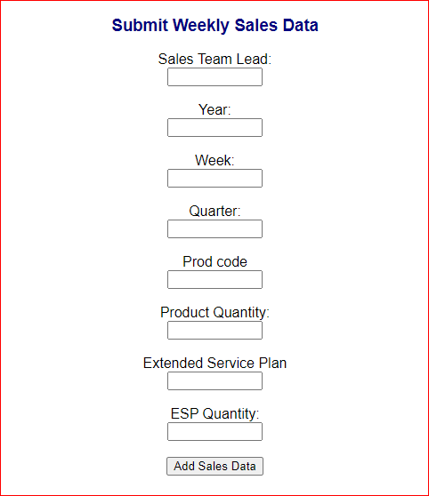
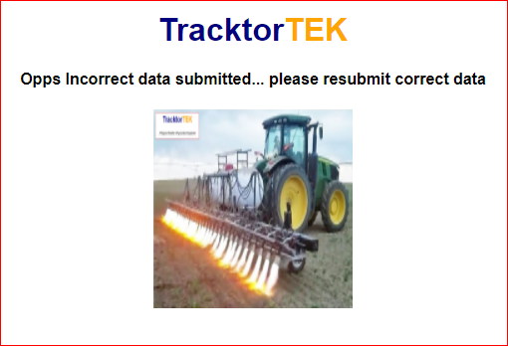
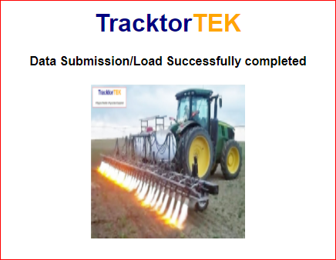
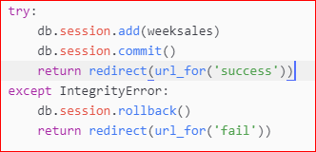
Web UI Sales records (OLTP)
On Commit Error
On Commit Success
Form Allows submission weekly sales data
This form checks integrity constraints of incorrect submission and rollback and suggest to resubmit correct data.
URL for Web UI : http://127.0.0.1:5000/

Slide 8
TractorTEK
Sales Dashboard, and Analysis Findings​

Slide 9
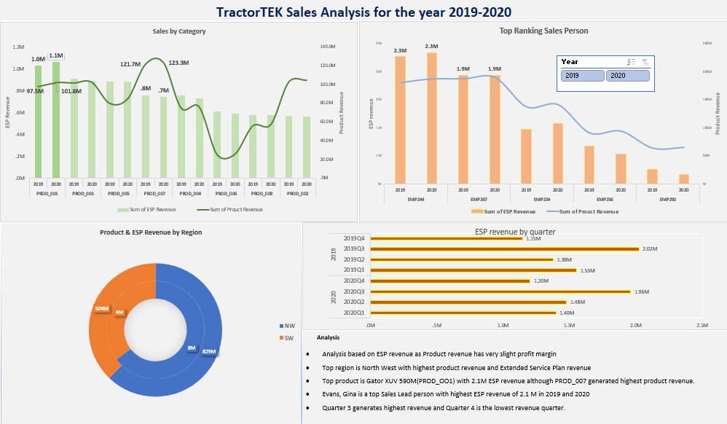

Slide 10
TractorTEK
Capstone Project -1
Database consistency through Jupyter Note Book

Slide 11
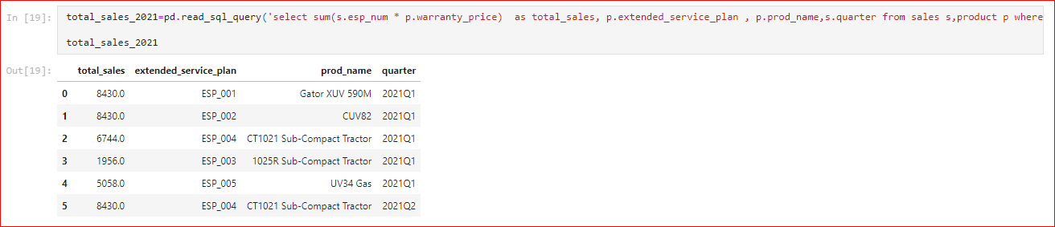
Database consistency through Jupyter Note Book
Screen shot of the join query on product and sales table from TrackorTEC database
mayekar_capstone - Jupyter Notebook

Slide 12
TractorTEK
TractorTEK
Capstone Project -1
Value to Customer

Slide 13
Value to customer
TractorTEK’s Sales Web UI and database system will restore through this restoration program.
As a part of restoration, new schema will be created and new Web UI application will be launched.
TrackTEK’s financial impact will minimize as Sales data is directly related to profit of the organization
This system will give confidence to the Sales Team ,management and indirect impact to the end users who consume this product.

Slide 14
Project Material

Slide 15
THANK YOU
TractorTEK
Capstone Project -1

